Slide 1
Regression with Time-Series Data:
Nonstationary Variables
Part 1
BUAN / MECO 6312
Dr. Moran Blueshtein
University of Texas - Dallas

Slide 2
Stationary and Nonstationary Variables

Slide 3
Stationary and Nonstationary Variables
Formally, a time series y_{t} is stationary if:
Its mean is constant over time and,
Its variance is constant over time and,
If the covariance between two values from the series depends only on the length of time separating the two values, and not on the actual times at which the variables are observed.

Slide 4
Stationary and Nonstationary Variables
The AR(1) is useful for explaining the difference between stationary and non-stationary series:
The errors v_{t} are not correlated, with zero mean and constant variance

Slide 5
Stationary and Nonstationary Variables
The mean of the AR(1) process:
If and t is sufficiently large, then is negligible:

Slide 6
Stationary and Nonstationary Variables
The variance of the AR(1) process
And the covariance between two errors s period apart is:
AR(1) process is stationary if
The AR(1) in this example is stationary around 0 mean (figure a)

Slide 7
Stationary and Nonstationary Variables
Stationarity around a Non – 0 Mean
Real-world data often don’t have a zero mean
We say that the “de-meaned” variable is stationary around 0.
Or that the variable is stationary around (figure b).

Slide 8
Stationary and Nonstationary Variables
Stationarity around a Linear Trend
AR(1) model can also fluctuate around a linear trend: (μ + δt)
is not stationary, however….
The ‘‘de-trended’’ series (y_{t} -μ - δt) will be stationary.
is often described as stationary around a deterministic trend (figure c)

Slide 9
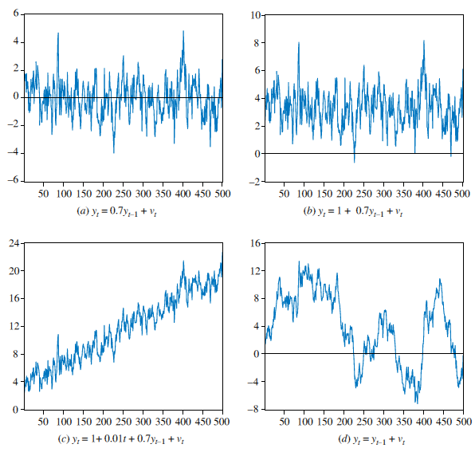
Stationary and Nonstationary Variables
Time-Series Models

Slide 10
Stationary and Nonstationary Variables
Random Walk Models
Consider the special case of ρ = 1:
These time series are called random walks because they appear to wander slowly upward or downward with no real pattern (figure d).

Slide 11
Stationary and Nonstationary Variables
Random Walk Models
is called stochastic trend
a stochastic component v_{t} is added for each time t, and causes the time series to trend in unpredictable directions

Slide 12
Stationary and Nonstationary Variables
Random Walk Models
Random walk is NOT stationary.
Mean is constant:
However, the variance increases over time, eventually becoming infinite
This implies that the series may not return to its mean, so sample mean taken for different periods are not the same.

Slide 13
Stationary and Nonstationary Variables
Random Walk with a Drift
Random Walk Models
A variation of model is obtained by adding a constant term:
This model is known as the random walk with drift

Slide 14
Stationary and Nonstationary Variables
Random Walk Models
A better understanding is obtained by applying recursive substitution:
The term tα is a deterministic trend component because a fixed value α is added for each time t
The variable y wanders up and down as well as increases by a fixed amount at each time t (figure e)

Slide 15
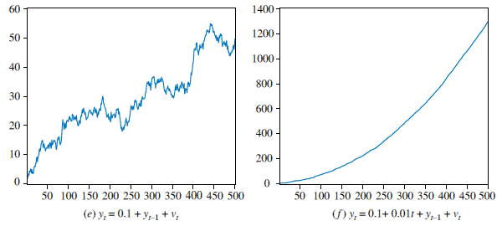
Stationary and Nonstationary Variables

Slide 16
Stationary and Nonstationary Variables
Random Walk Models
Now both mean and variance of y_{t} are not constant:

Slide 17
Stationary and Nonstationary Variables
Random Walk Models
We can extend the random walk model even further by adding a time trend
The addition of a time-trend variable t strengthens the trend behavior (figure f):
where we used:

Slide 18
Regression with Time-Series Data:
Nonstationary Variables
Part 2
BUAN / MECO 6312
Dr. Moran Blueshtein
University of Texas - Dallas

Slide 19
Spurious Regressions

Slide 20
Spurious Regressions
It is important to know whether a time series is stationary or non-stationary.
When nonstationary series are used in regression analysis there is a danger of obtaining apparently significant regression results from unrelated data.
Such regressions are said to be spurious

Slide 21
Spurious Regressions
Consider two independent random walks:
These series were generated independently and, in truth, have no relation to one another.

Slide 22
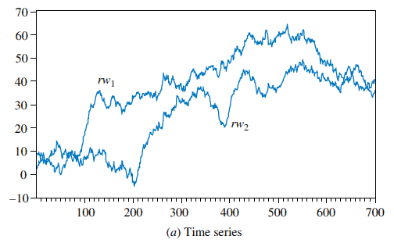
Spurious Regressions
Time series and scatter plot of two random walk variables
Yet when plotted, we see a positive relationship between them!

Slide 23
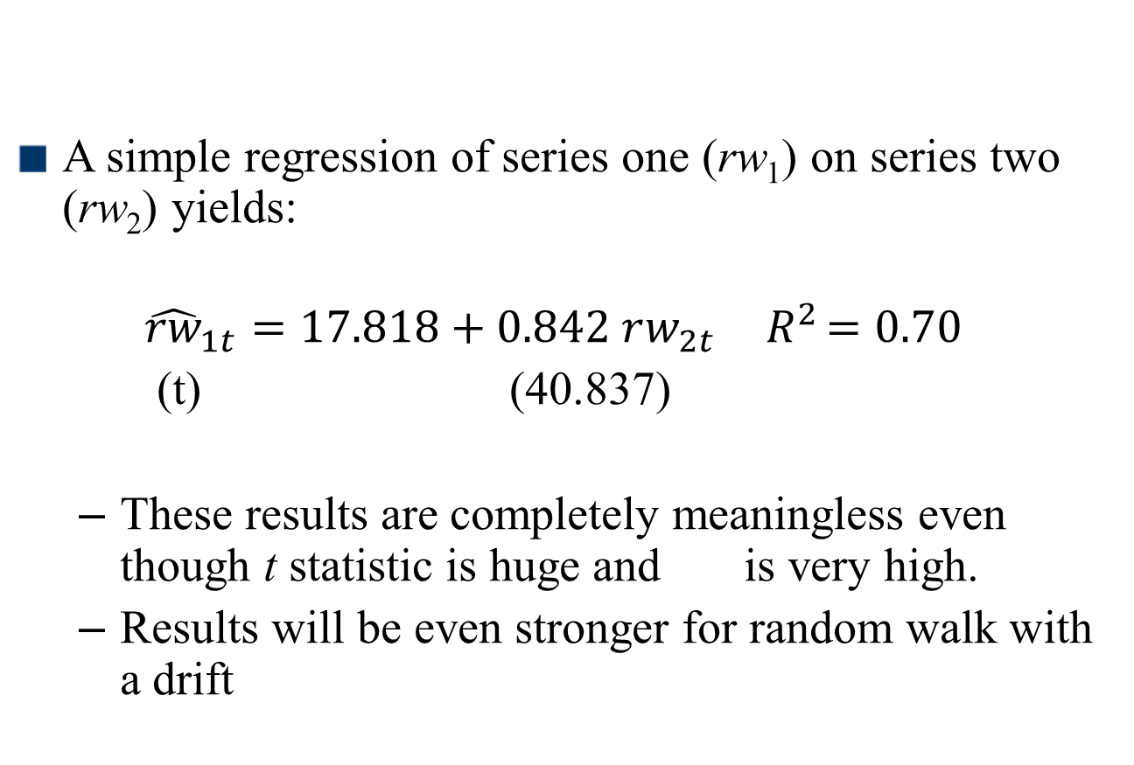
Spurious Regressions
A simple regression of series one (rw₁) on series two (rw₂) yields:
$${\hat{rw}}_{1t}=17.818+0.842 rw_{2t}{ R}^{2}=0.70$$
(t) (40.837)
These results are completely meaningless even though t statistic is huge and is very high.
Results will be even stronger for random walk with a drift

Slide 24
Spurious Regressions
Since many macroeconomic time series are nonstationary, it is particularly important to take care when estimating regressions with macroeconomic variables
Notes:
When nonstationary time series are used in a regression model, the results may spuriously indicate a significant relationship when there is none.

Slide 25
Unit Root Tests for Stationarity

Slide 26
Unit Root Tests for Stationarity
Dickey – Fuller Unit Root Tests for Stationarity
Dickey-Fuller Test 1 (No constant and No Trend)
Consider the AR(1) model:
We can test for nonstationarity by testing the null hypothesis that ρ = 1 against the alternative that ρ < 1
Notes:
AR (1) model is a model with no constant and no trend.

Slide 27
Unit Root Tests for Stationarity
Dickey-Fuller Test 1 (No constant and No Trend)
A more convenient form is:
The hypotheses are:

Slide 28
Unit Root Tests for Stationarity
Dickey-Fuller Test 2 (With Constant but No Trend)
The second Dickey–Fuller test includes a constant term in the test equation:
The null and alternative hypotheses are the same as before

Slide 29
Unit Root Tests for Stationarity
Dickey-Fuller Test 3 (With Constant and With Trend)
The third Dickey–Fuller test includes a constant and a trend in the test equation:
The null and alternative hypotheses are as before:
H₀: γ = 0 and H₁:γ < 0

Slide 30
Unit Root Tests for Stationarity
If we reject the null hypothesis we conclude that the series is stationary.
If we do not reject the null hypothesis, we conclude that the series is not stationary or that the series has a unit root

Slide 31
Unit Root Tests for Stationarity
The Dickey-Fuller Testing Procedures
The Dickey-Fuller testing procedure:
First plot the time series of the variable and select a suitable Dickey-Fuller test based on a visual inspection of the plot
If the series appears to be wandering or fluctuating around a sample average of zero, use test 1
If the series appears to be wandering or fluctuating around a sample average which is nonzero, use test 2.
If the series appears to be wandering or fluctuating around a linear trend, use test 3.

Slide 32
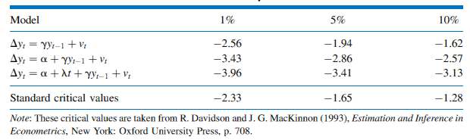
Unit Root Tests for Stationarity
Critical Values for the Dickey–Fuller Test
This t-statistic no longer has the t-distribution under the null hypothesis.
Instead, we use the statistic often called a τ (tau) statistic
Critical values for one tail (left) are given in the following table:

Slide 33
Unit Root Tests for Stationarity
Augmented Dickey–Fuller Test
An important extension of the Dickey-Fuller test allows for the possibility that the error term is auto-correlated.
Such auto-correlation is likely to occur if our earlier models did not have sufficient lags to capture all full dynamic nature in the process.
The solution: we will add lags of the dependent variable until we eliminate auto-correlation in the residuals, and only then we will conduct the Dickey-Fuller test.
This is the augmented Dickey-Fuller test.

Slide 34
Unit Root Tests for Stationarity
The Dickey-Fuller Tests: An Example
As an example, consider the two interest rate series:
The federal funds rate (F_{t})
The three-year bond rate (B_{t})

Slide 35
Unit Root Tests for Stationarity
The Dickey-Fuller Tests: An Example

Slide 36
Regression When There is No Cointegration
First Difference Stationary
Consider the random walk model:
This can be rendered stationary by taking the first difference:
The variable y_{t} is said to be a first difference stationary series

Slide 37
Unit Root Tests for Stationarity
Order of Integration
Series like y_{t}, which can be made stationary by taking the first difference, are also said to be integrated of order one, and denoted as I(1)
Stationary series are said to be integrated of order zero, I(0)
In general, the order of integration of a series is the minimum number of times it must be differenced to make it stationary

Slide 38
Unit Root Tests for Stationarity
Order of Integration
The results of the Dickey–Fuller test for a random walk applied to the first differences are:

Slide 39
Unit Root Tests for Stationarity
Order of Integration
Based on the large negative value of the t statistic (-5.487 < -1.95), we reject the null hypothesis that ΔF_{t} is nonstationary and accept the alternative that it is stationary.
We similarly conclude that ΔB_{t} is stationary
(-7.662 < -1.95)
Conclusion: F and B are both integrated of order 1.

Slide 40
First Difference Stationary
If the series are difference stationary – by taking first differences
Suppose that y and x are I(1), an example of an ARDL(1,1) regression equation is:

